Slide 1
Project of Walmart Sales Analysis
Notes:
© Copyright PresentationGO.com – The free PowerPoint and Google Slides template library

Slide 2
Who is Walmart?
Walmart Inc. (formerly Wal-Mart Stores, Inc.) is an American multinational retail corporation that operates a chain of hypermarkets (also called supercenters), discount department stores, and grocery stores in the United States, headquartered in Bentonville, Arkansas.
The company was founded by brothers Sam and James "Bud" Walton in nearby Rogers, Arkansas in 1962 and incorporated under Delaware General Corporation Law on October 31, 1969.
It also owns and operates Sam's Club retail warehouses.
Notes:
© Copyright PresentationGO.com – The free PowerPoint and Google Slides template library

Slide 3
As of October 31, 2022, Walmart has 10,586 stores and clubs in 24 countries, operating under 46 different names.
The company operates under the name Walmart in the United States and Canada, as Walmart de México y Centroamérica in Mexico and Central America, and as Flipkart Wholesale in India.
It has wholly owned operations in Chile and a majority stake in Massmart in South Africa. Since August 2018, Walmart held only a minority stake in Walmart Brasil, which was renamed Grupo Big in August 2019, with 20 percent of the company's shares, and private equity firm Advent International holding 80% ownership of the company.
They eventually divested their shareholdings in Grupo Big to French retailer Carrefour, in transaction worth R$7 billion and completed on June 7, 2022.
Notes:
© Copyright PresentationGO.com – The free PowerPoint and Google Slides template library

Slide 4
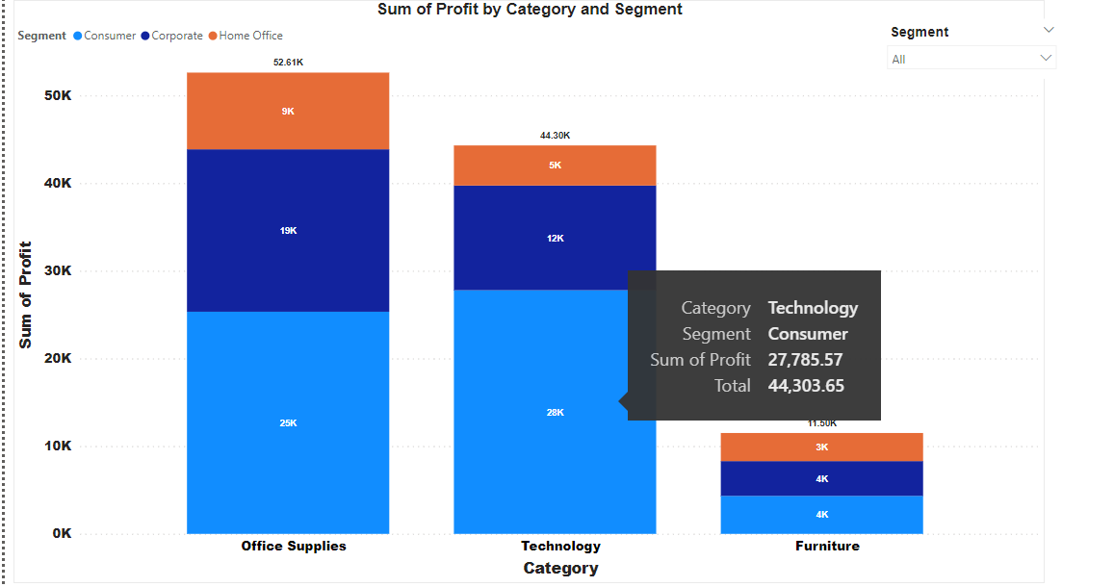

Slide 5
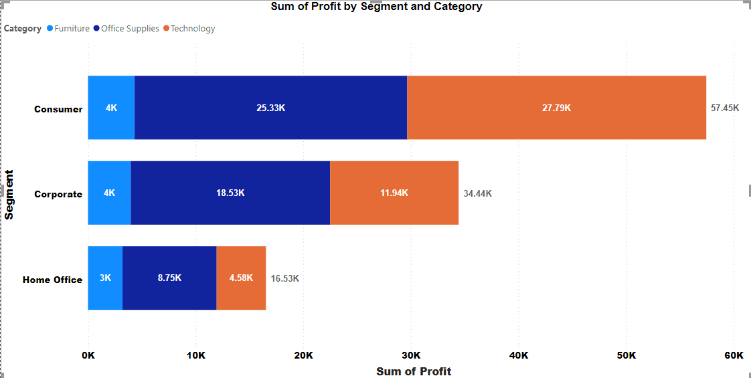
Notes:
© Copyright PresentationGO.com – The free PowerPoint and Google Slides template library

Slide 6
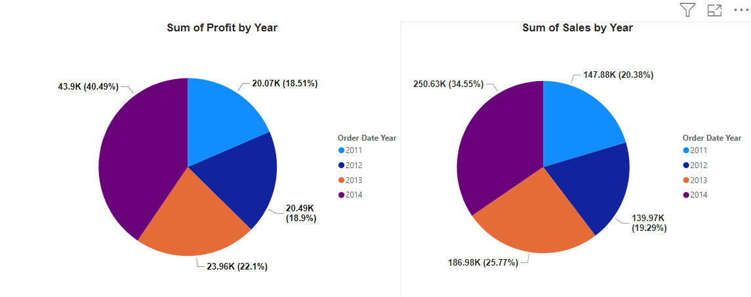
Notes:
© Copyright PresentationGO.com – The free PowerPoint and Google Slides template library

Slide 7
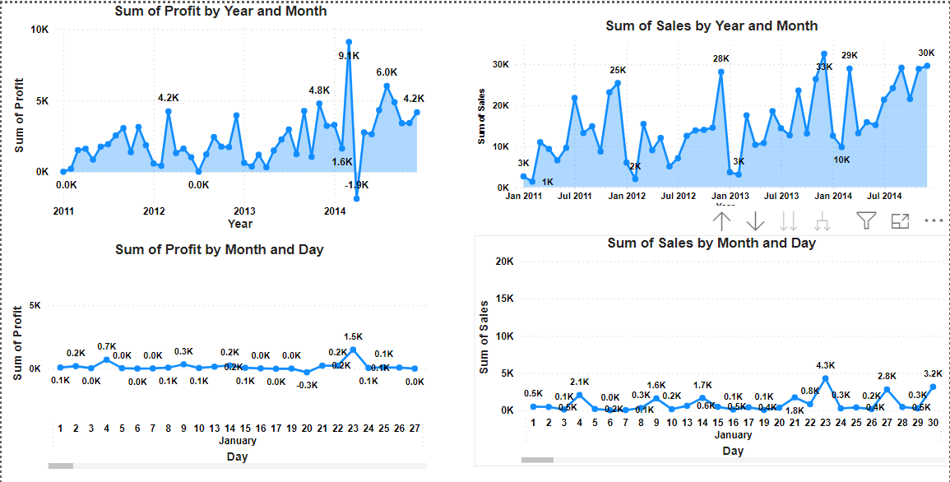
Notes:
© Copyright PresentationGO.com – The free PowerPoint and Google Slides template library

Slide 8
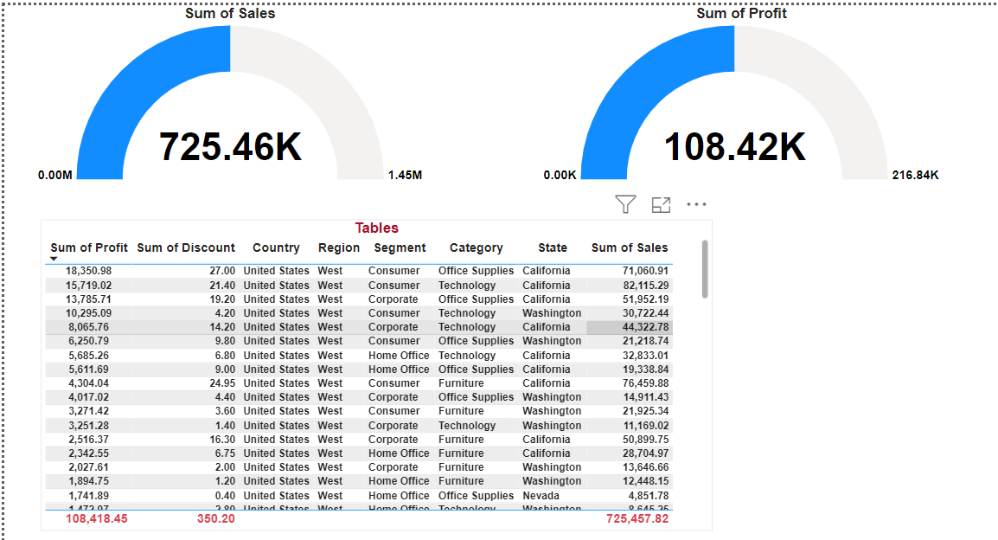
Notes:
© Copyright PresentationGO.com – The free PowerPoint and Google Slides template library

Slide 9
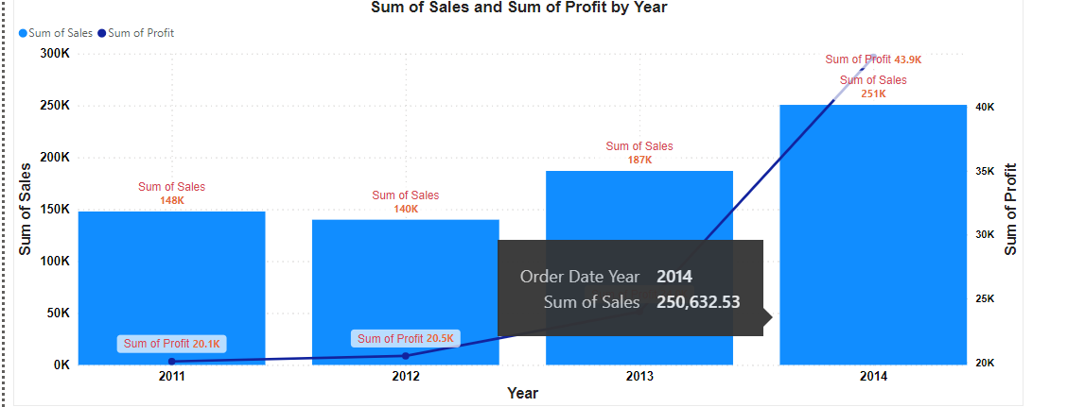
Notes:
© Copyright PresentationGO.com – The free PowerPoint and Google Slides template library

Slide 10
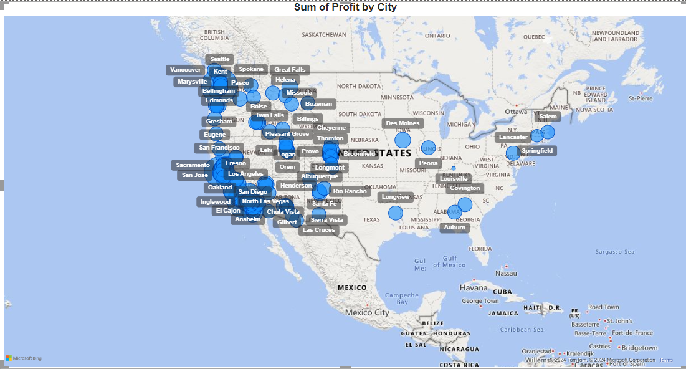
Notes:
© Copyright PresentationGO.com – The free PowerPoint and Google Slides template library

Slide 11
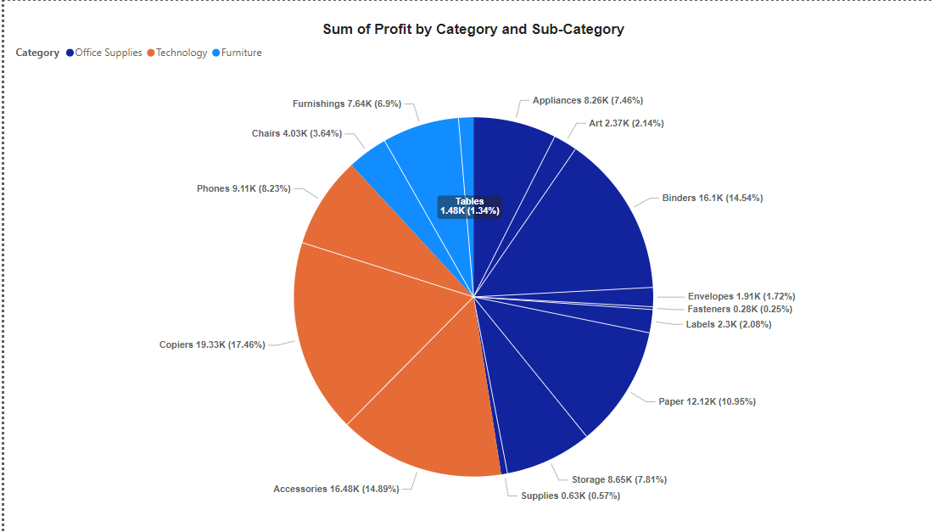
Notes:
© Copyright PresentationGO.com – The free PowerPoint and Google Slides template library

Slide 12
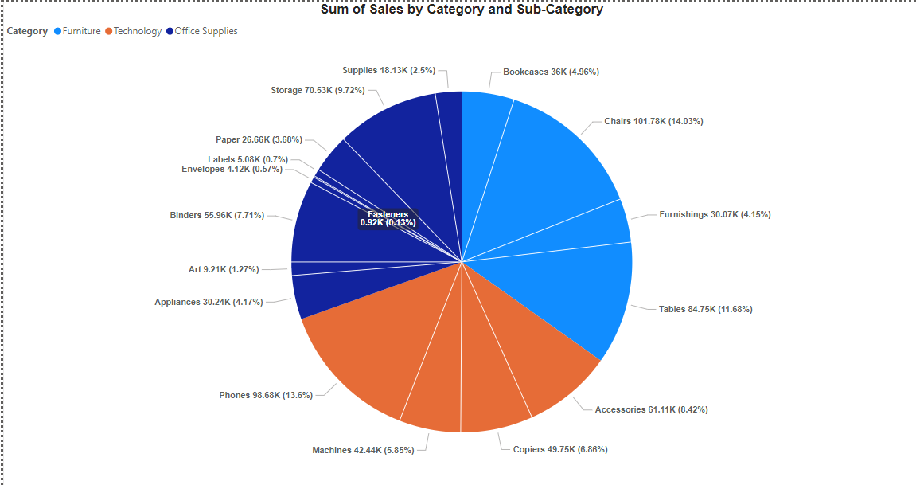
Notes:
© Copyright PresentationGO.com – The free PowerPoint and Google Slides template library

Slide 13
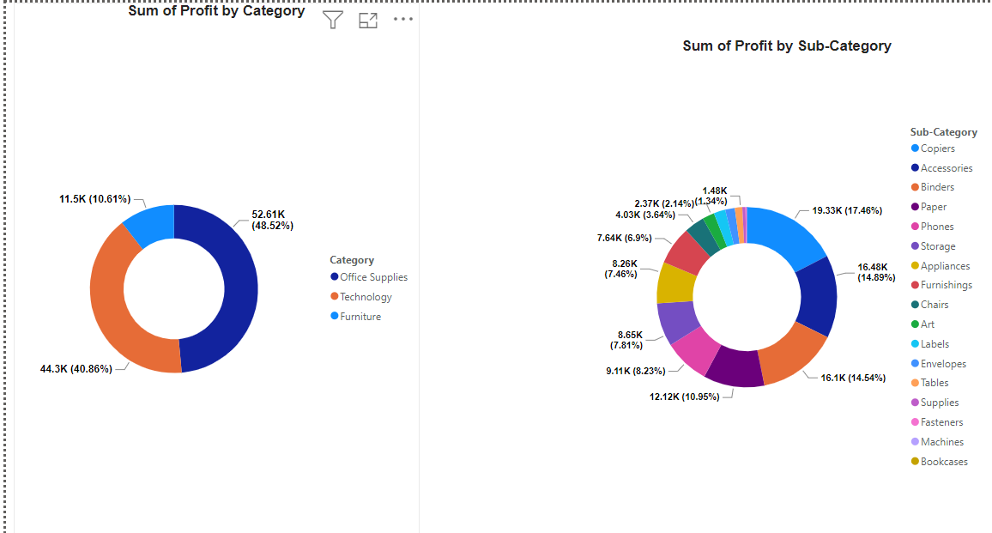
Notes:
© Copyright PresentationGO.com – The free PowerPoint and Google Slides template library

Slide 14
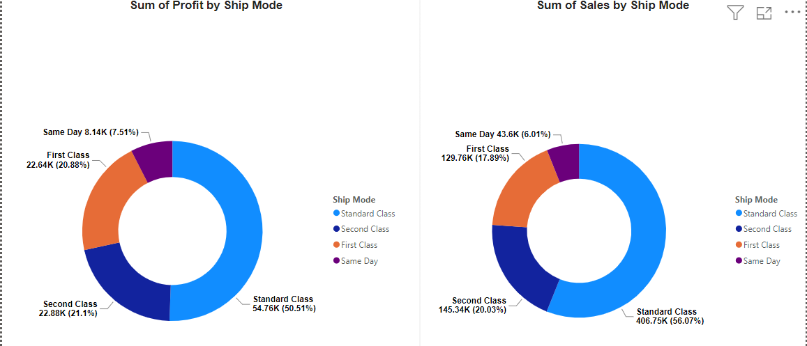
Notes:
© Copyright PresentationGO.com – The free PowerPoint and Google Slides template library

Slide 15
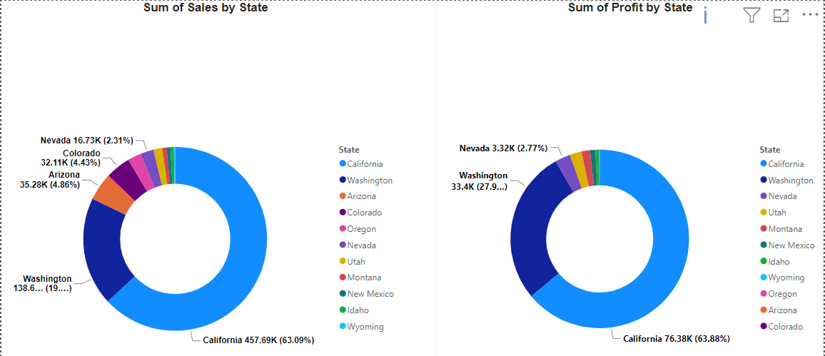
Notes:
© Copyright PresentationGO.com – The free PowerPoint and Google Slides template library

Slide 16
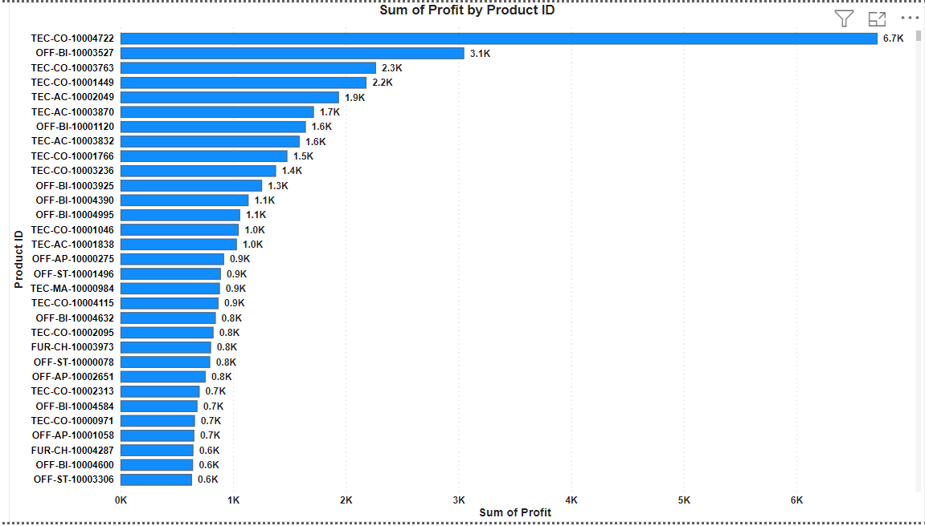
Notes:
© Copyright PresentationGO.com – The free PowerPoint and Google Slides template library

Slide 17
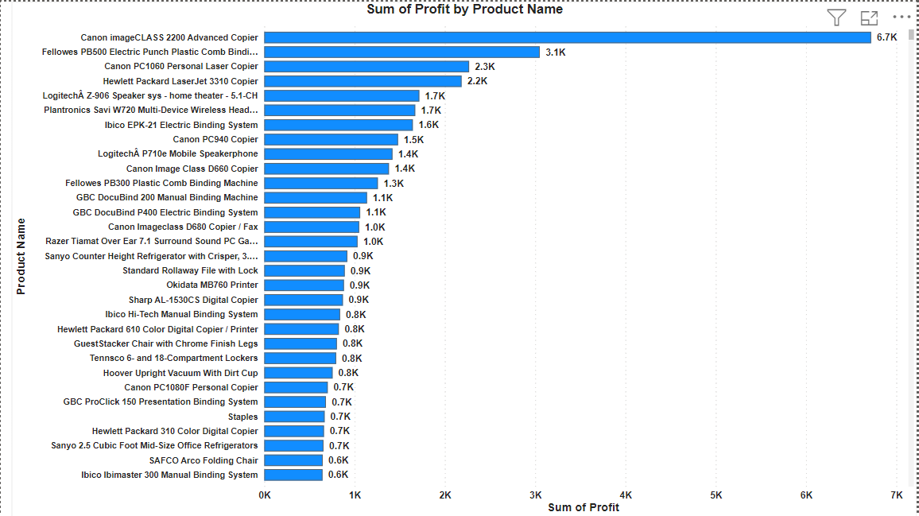
Notes:
© Copyright PresentationGO.com – The free PowerPoint and Google Slides template library

Slide 18
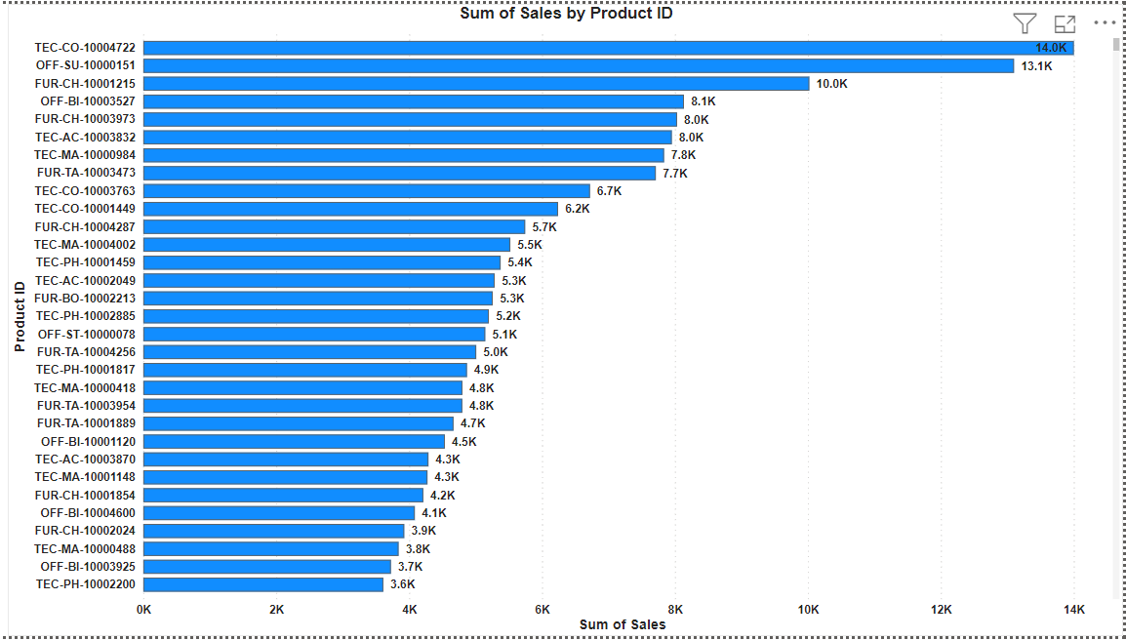
Notes:
© Copyright PresentationGO.com – The free PowerPoint and Google Slides template library

Slide 19
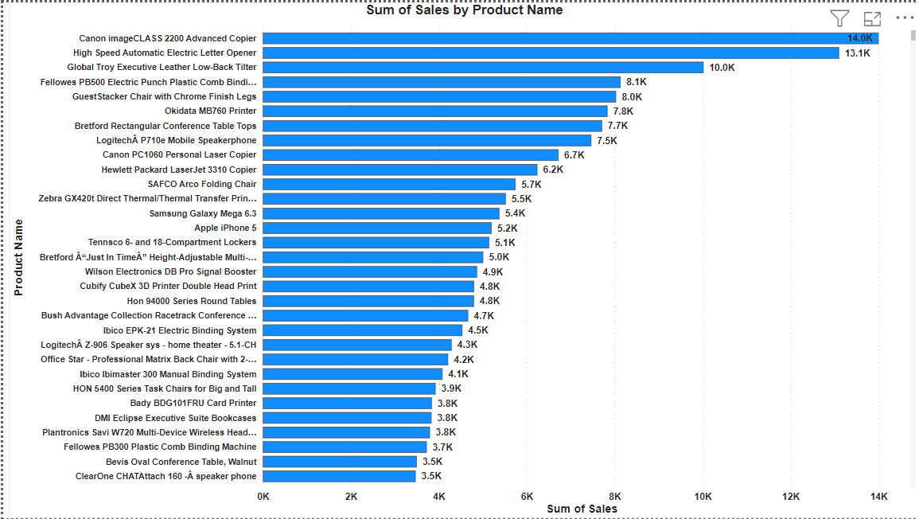
Notes:
© Copyright PresentationGO.com – The free PowerPoint and Google Slides template library

Slide 20
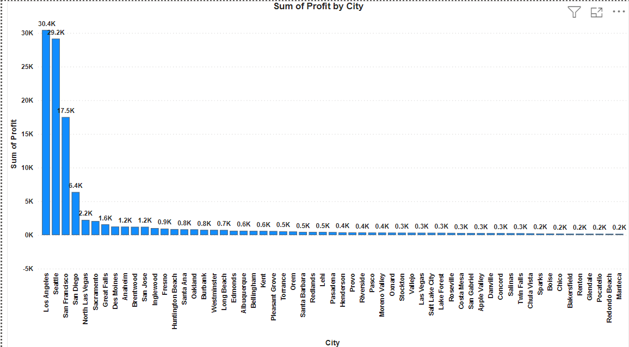
Notes:
© Copyright PresentationGO.com – The free PowerPoint and Google Slides template library

Slide 21
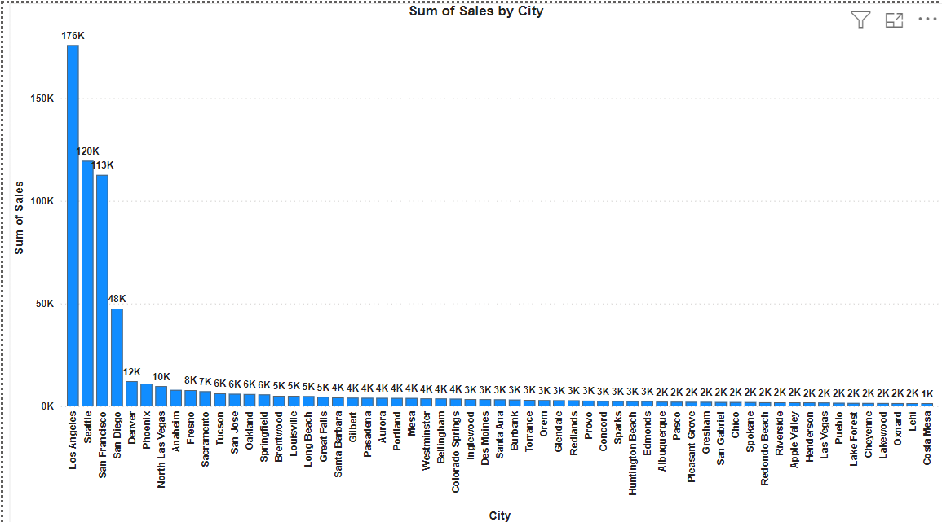
Notes:
© Copyright PresentationGO.com – The free PowerPoint and Google Slides template library

Slide 22
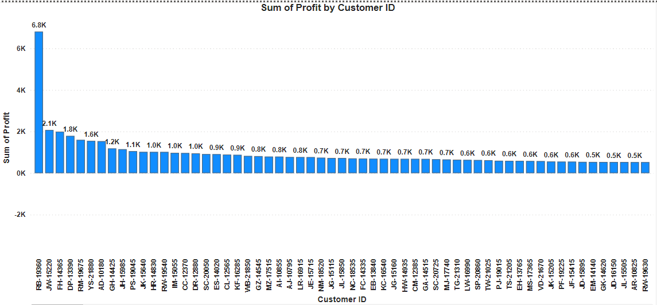
Notes:
© Copyright PresentationGO.com – The free PowerPoint and Google Slides template library

Slide 23
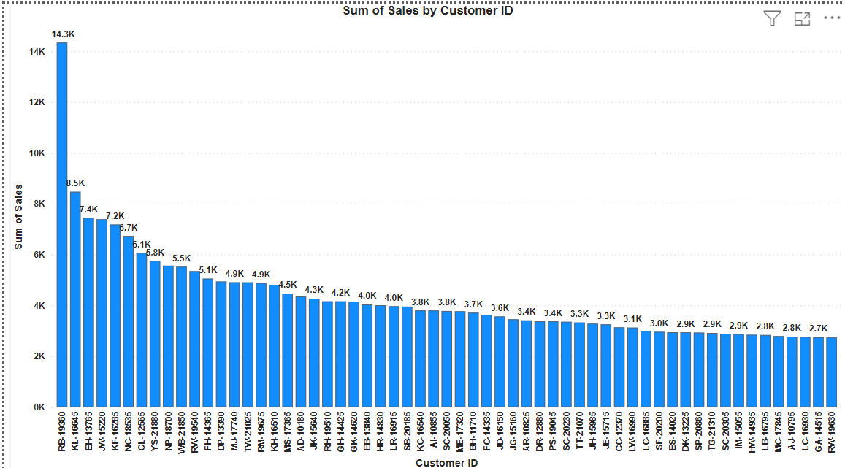
Notes:
© Copyright PresentationGO.com – The free PowerPoint and Google Slides template library

Slide 24

Notes:
© Copyright PresentationGO.com – The free PowerPoint and Google Slides template library

Slide 25
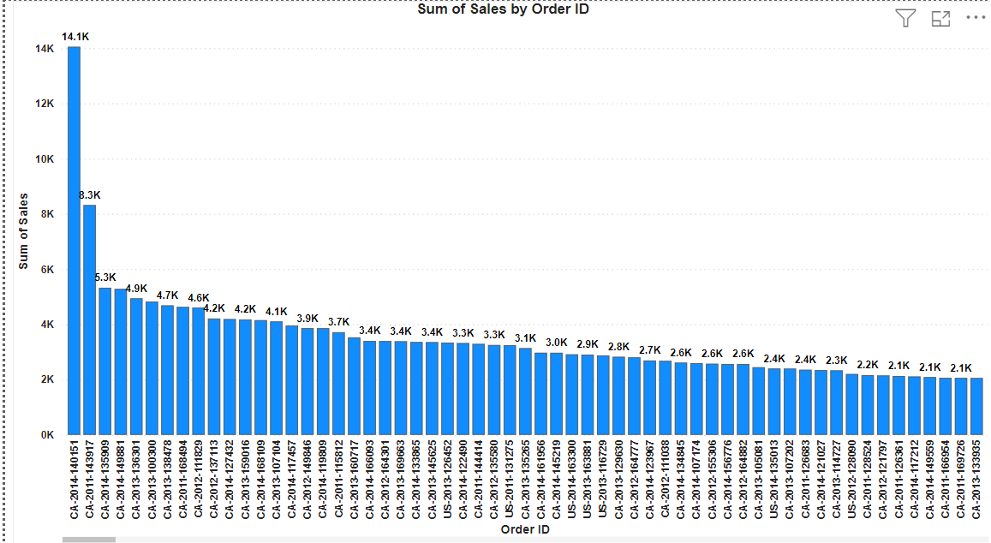
Notes:
© Copyright PresentationGO.com – The free PowerPoint and Google Slides template library

Slide 26
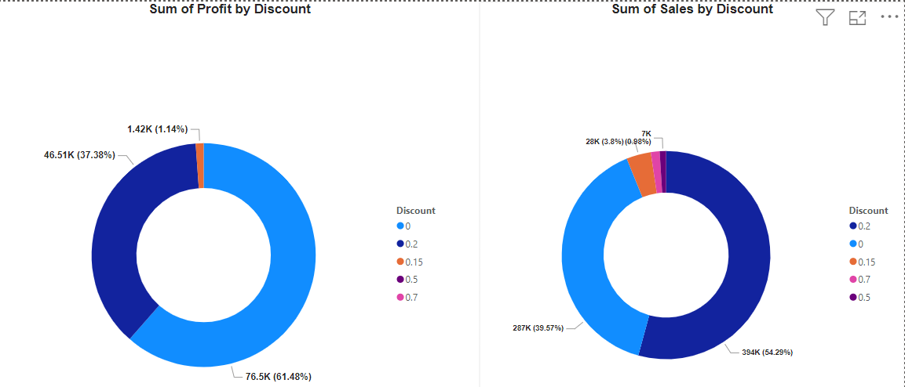
Notes:
© Copyright PresentationGO.com – The free PowerPoint and Google Slides template library

Slide 27
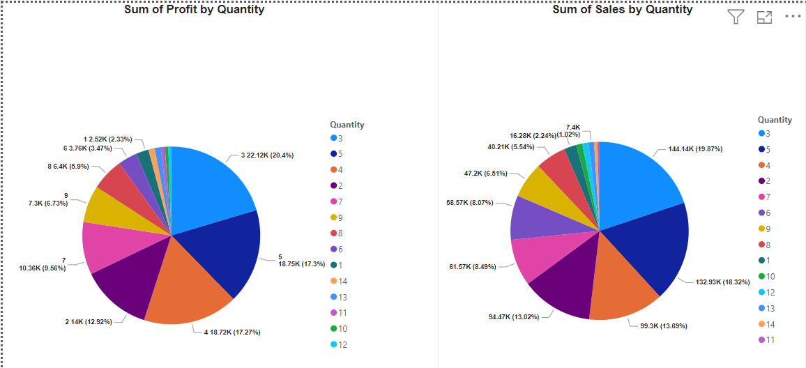
Notes:
© Copyright PresentationGO.com – The free PowerPoint and Google Slides template library

Slide 28
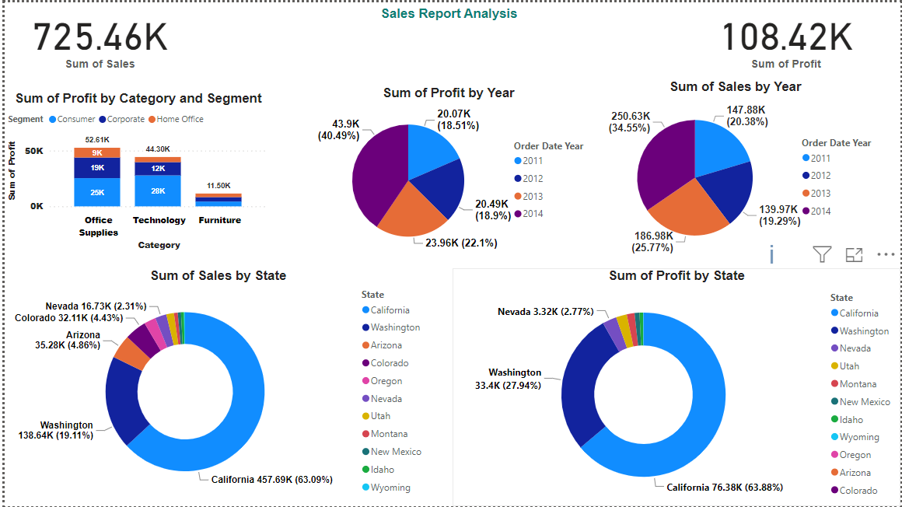
Notes:
© Copyright PresentationGO.com – The free PowerPoint and Google Slides template library

Slide 29
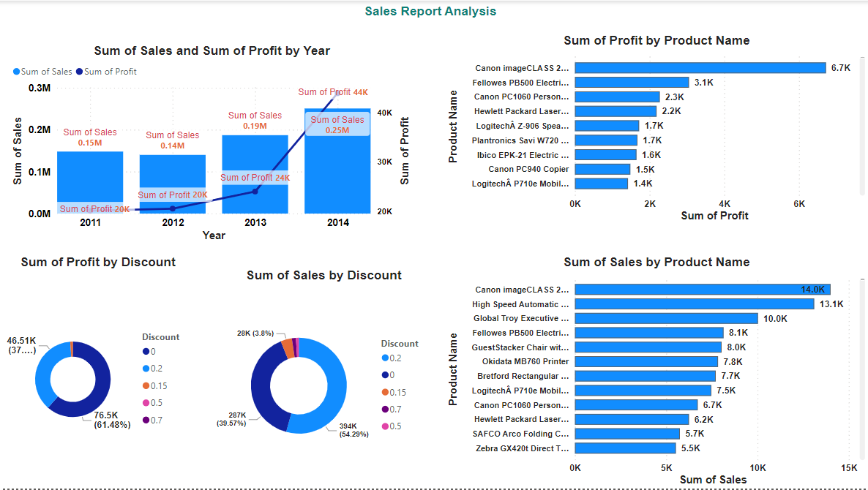
Notes:
© Copyright PresentationGO.com – The free PowerPoint and Google Slides template library

Slide 30
Root cause of Walmart Sales Analysis
Several factors could contribute to an increase in sales for Walmart:
Economic Conditions: Improvements in the economy, such as lower unemployment rates or increased consumer confidence through marketing strategies can lead to higher consumer spending overall, benefiting retailers like Walmart.
Seasonal Trends: Seasonal factors, such as holiday shopping seasons or back-to-school periods, often result in increased sales for retailers. Walmart typically can experience spikes in sales during these times.
Marketing and Promotions: Effective marketing campaigns, discounts, and promotions in both online and offline stores can attract more customers to Walmart stores and encourage them to spend more.
Notes:
© Copyright PresentationGO.com – The free PowerPoint and Google Slides template library

Slide 31
Expansion and Store Openings: Opening new stores or expanding existing ones can lead to increased sales as Walmart reaches new markets or increases its presence in existing ones.
E-commerce Growth: The growth of online shopping and Walmart's investment in its e-commerce platform can result in increased sales as more customers choose to shop online.
Product Assortment: Offering a wide range of products, including both essential items and discretionary goods, can attract more customers and drive sales growth.
Operational Efficiency: Improvements in supply chain management, inventory control, and store operations can help Walmart reduce costs and offer competitive prices, leading to increased sales.
Notes:
© Copyright PresentationGO.com – The free PowerPoint and Google Slides template library

Slide 32
Thank You!
Notes:
© Copyright PresentationGO.com – The free PowerPoint and Google Slides template library

